Slide 1
MICRO CREDIT DEFAULTER PROJECT
Presented by-
Akanksha Srivastava

Slide 2
PROBLEM DEFINITION
This is a basic problem which helps Micro Finance Institutions (MFI) & other lending companies reduce credit risks by recognizing defaulters.

Slide 3

Micro Finance Institute(MFIs) Microfinance institutions (MFIs) are financial companies that provide small loans to people who do not have any access to banking facilities. The definition of “small loans” varies between countries. In India, all loans that are below Rs.1 lakh can be considered as microloans.

Slide 4

Background
Prior to the advancement of data science, lenders used to risk a high default rate. Several times, a perfect candidate would display erratic financial & repayment behavior once approved for the loan.
Machine Learning can help lenders predict potential defaults before endorsing their application using their past data.
The candidate’s income, past debt & repayment behavior can be important metrics for the same.

Slide 5
INTRODUCTION
We are working with one such client i.e. in Telecom Industry
They are fixed wireless telecommunications network provider.
They have launched various products and have developed its business and organization based on the budget operator model, offering better products at lower prices to all value conscious customer through a strategy of disruptive innovation that focuses on the subscriber.

Slide 6
Introduction contd….
Telecom Industry are collaborating with an MFI to provide micro-credit on mobile balances to be paid back in 5 days.
The customer is believed to be defaulter if he deviates from the path of paying back the loaned amount within the time duration of 5 days.
For the loan amount of 5(in Indonesian Rupiah), payback amount should be 6(in Indonesian Rupiah), while for the loan amount of 10(in Indonesian Rupiah), the payback amount should be 12( in Indonesian Rupiah).

Slide 7

Introduction contd….
The sample data is provide to us from our client database.
It this order is given to improve the selection of customers for the credit, the client wants some predictions that could help them in further investment and improvement in selection of customers.

Slide 8
Problem Statement
Build a model which can be used to predict in terms of a probability for each loan transaction, whether the customer will be paying back the loaned amount within 5 days of insurance of loan.
In this case, Label ‘1’ indicates that the loan has been payed i.e. Non-defaulter, while, Label ‘0’ indicates that the loan has not been payed i.e. defaulter.

Slide 9
EDA CONCLUDING REMARKS
Exploratory Data Analysis (EDA) is an initial process of analysis, in which we can summarize characteristics of data such as pattern, trends, outliers, and hypothesis testing using descriptive statistics and visualization.
There are no null values in the dataset
The dataset is imbalanced. Label ‘1’ has approximately 87.5% records, while, label ‘0’ has approximately 12.5% records.
Outliers are present.

Slide 10
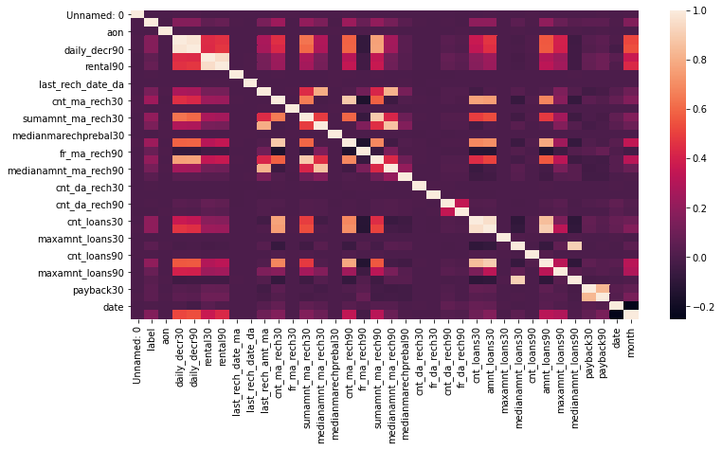
DATA VISULISATION

Slide 11
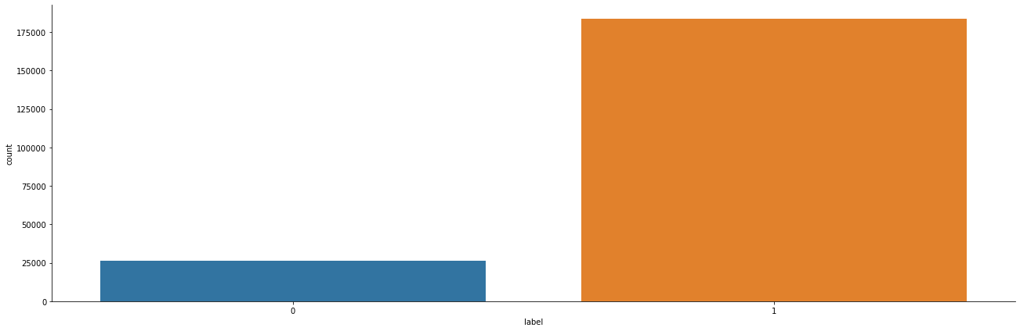
PRE PROCESSING PIPELINE

Slide 12
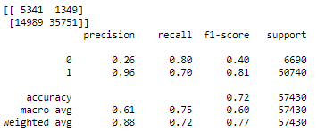
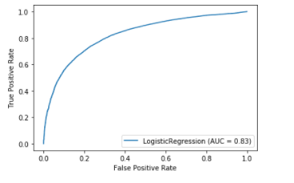
ANALYSIS OF THE OUTPUT OF EACH MODEL 1.Logistic Regression-

Slide 13
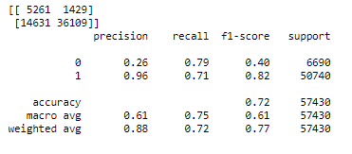
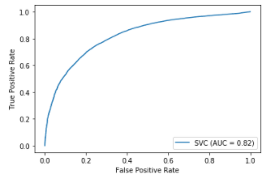
2.Support Vector Machine(SVM)

Slide 14
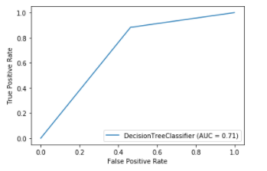
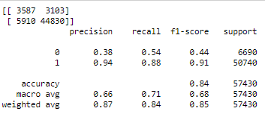
3.Decision Tree

Slide 15
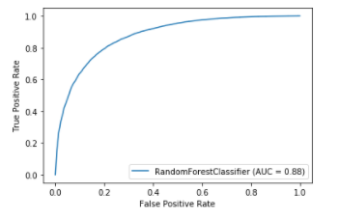
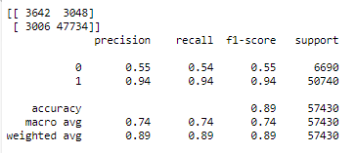
4.Random Forest

Slide 16
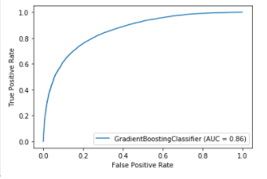
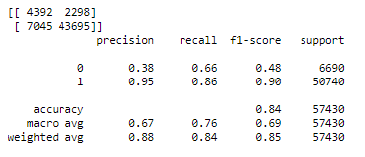
5.Gradient Boosting Classifier

Slide 17
CONCLUSION
According to the performance metrics, Random Forest scores highest in accuracy. So, Random Forest looks like the best fit for this data.

